Slide 1
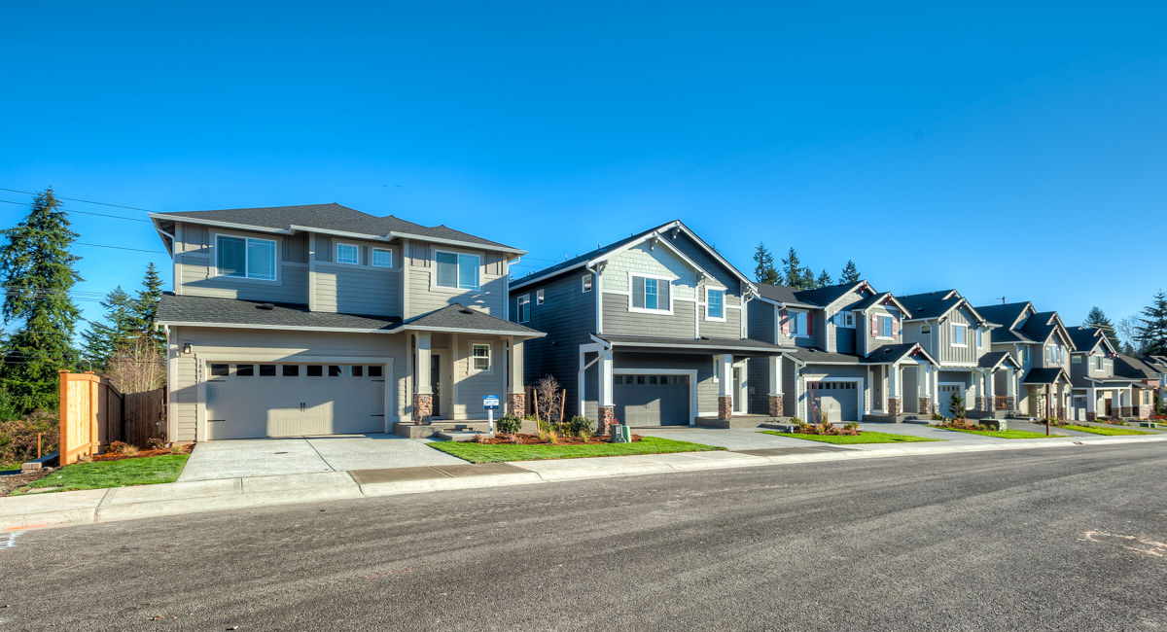

What makes a House Affordable?
AI-1 Cohort-4 Project
By: Shishir Tripathi, Ruchin Dhama, Gursimran Singh, Rajat

Slide 2
Introduction
Problem Statement:
Approach:
Chosen Algorithm:
* Buying anything in the market whose MRP is not set gets a lot harder when the buyer don’t even know what the price is affected by, like in the case of buying a House.
* Based on dataset and findings we want to:
Explain what are the important factors of house(sqft area, floors condition etc.) which makes a house affordable.
Show next time you go in market to buy house what you should pay more attention to.
How to find a rough estimate of a house’s price.
* Steps we took:
Analyse how different factors affects the house prices.
Figure out the correlation among the predictors themselves.
Based on very basic algorithms (like logistic regression) make sure the predictors are sufficient enough to roughly predict a house’s price.
Based on data turning it into classification problem (affordable vs not affordable).
Finally results and how confident are we about our results.
Linear/Logistic Regression: Using this type of model we tried to figure out whether or not our datapoints have some linear/polynomial relationship.
KNN: Then we moved to KNN to make use of similarity amongst the more closer datapoints and based on that then predicting the price.
Tree based: Finally we applied tree based algorithm to figure out underlying relationship as well as how well the neighbours define a datapoint.

Slide 3
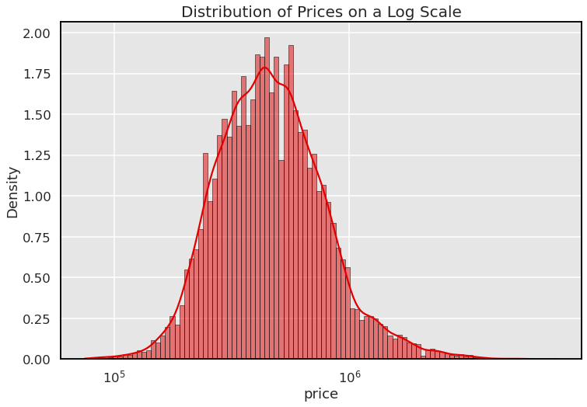
Methodology
Dataset - kc_house_data
The dataset consists of historic data of houses sold between May 2014 to May 2015 house prices in King County an area in the US State of Washington, this data also covers Seattle. The dataset was obtained from Kaggle. This data was published/released under CC0: Public Domain. The dataset consisted of 21 variables and 21613 observations. Following are few variables from dataset:
sqft_lot - Square footage of the land space
floors - Number of floors
waterfront - A dummy variable for whether the apartment was overlooking the waterfront or not
view - An index from 0 to 4 of how good the view of the property was
condition - An index from 1 to 5 on the condition of the apartment.
grade - An index from 1 to 13, where 1-3 falls short of building construction and design, 7 has an average level of construction and design, and 11-13 have a high quality level of construction and design.
sqft_above - The square footage of the interior housing space that is above ground level
sqft_basement - The square footage of the interior housing space that is below ground level
yr_built - The year the house was initially built
sqft_living15 - The square footage of interior housing living space for the nearest 15 neighbors

Slide 4
Methodology
Code & Packages Used
Sklearn
Data scaling and manipulation
Imblearn
For up-sampling our dataset
Pandas
Manipulating data-frames
Creating model
Testing and verification of models
Visualising dataset in tabular form
Numpy
Faster computation
Matplotlib
Visualizing data in graph form
Seaborn
For much prettier and interactive graphs
prettytable
For printing tables more elegantly
For more freedom

Slide 5
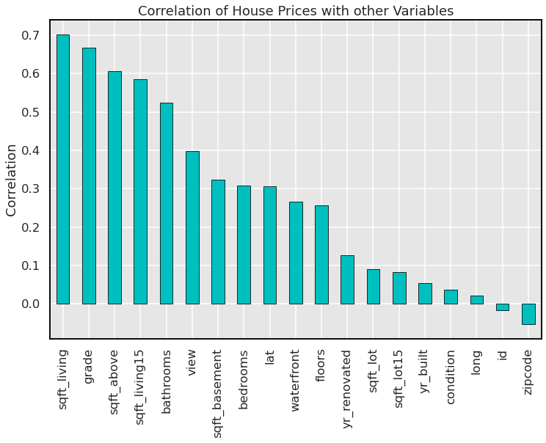
Exploratory Data Analysis
Correlation of prices with other predictors
Here we can clearly see that variables like sqft_living, grade, sqft_living15 shows a great correlation with price which suggests the price is not only dependent on this particular house grade and size but also the houses near it.
It’s also interesting to note here that house renovated date is a better variable than the original date of built of a house.
Features like longitude and zip-code doesn’t correlates with price that much.

Slide 6
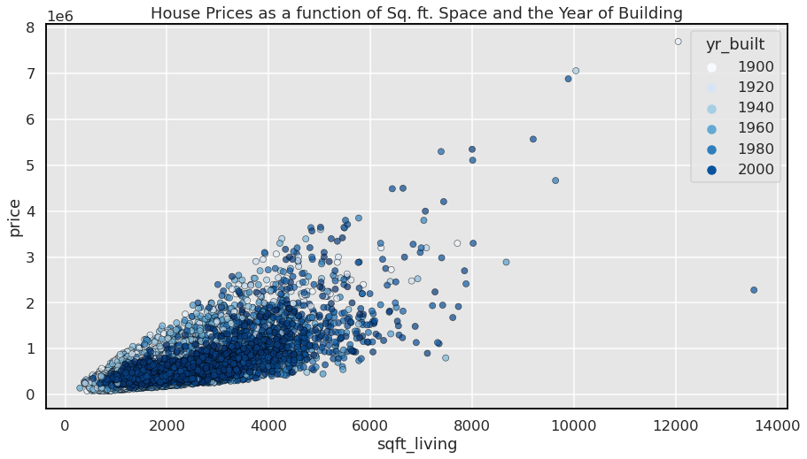
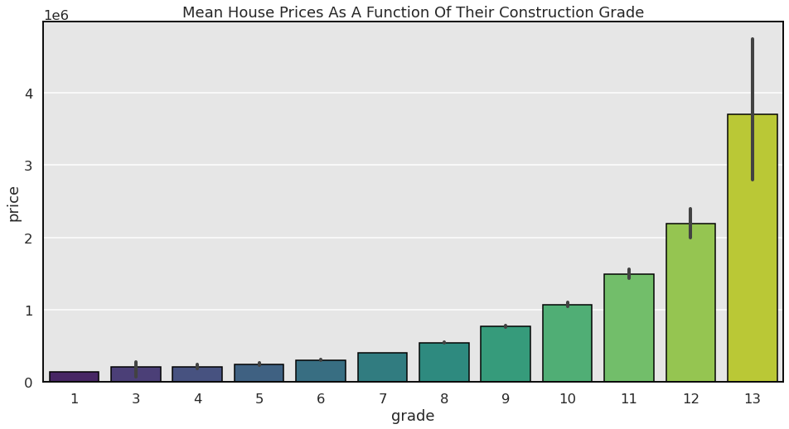
Exploratory Data Analysis
Other interesting findings
The scatter plot of price against the area of the house in sq.ft. shows a discernable linear trend. An interesting fact which emerged from classifying the houses according the year of building shows that the older houses with the same amount of area generally have a significantly higher price, almost being doubled or tripled in many cases.
In general, we expect newer houses with to have a higher price, but that is certainly not the case we see here.
This plot very well indicates an upward trend of prices as the construction grade of the House improves. This variable measures how good the design and construction of the House is, which understandably equates to a higher mean price for a high grade.

Slide 7
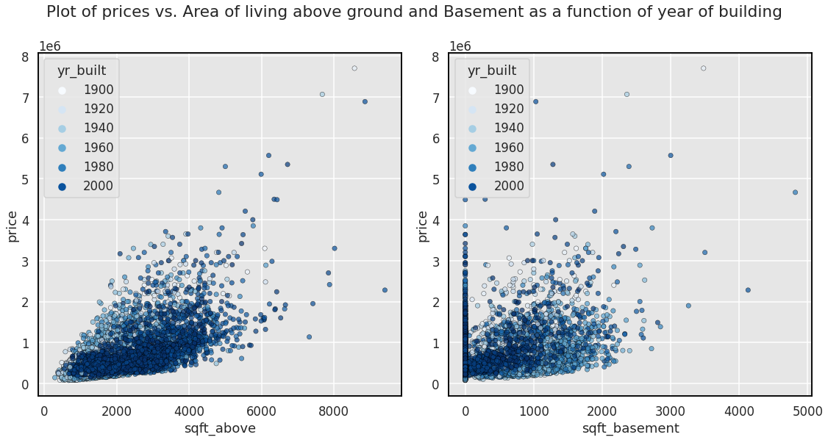
Exploratory Data Analysis
The plot for two features quantifying the area of living above ground and the area of basement, both of which show somewhat similar trends. The more interesting fact here is the spread in area of basement with years. We see a lot of houses built recently with no basement area , while most older houses having the same and also possessing very large areas of basement as well. This shows that there is a gradual decline towards preferring a basement while building a house.

Slide 8
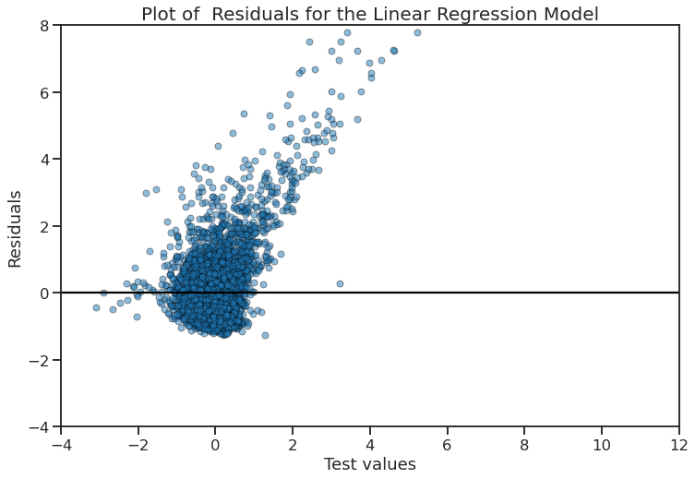
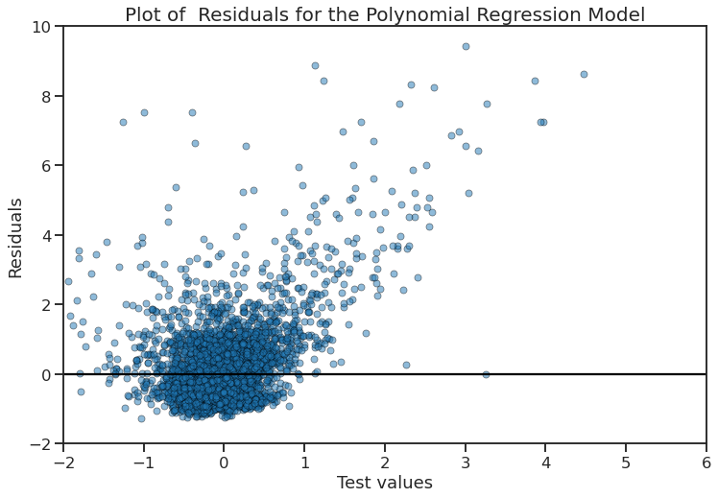
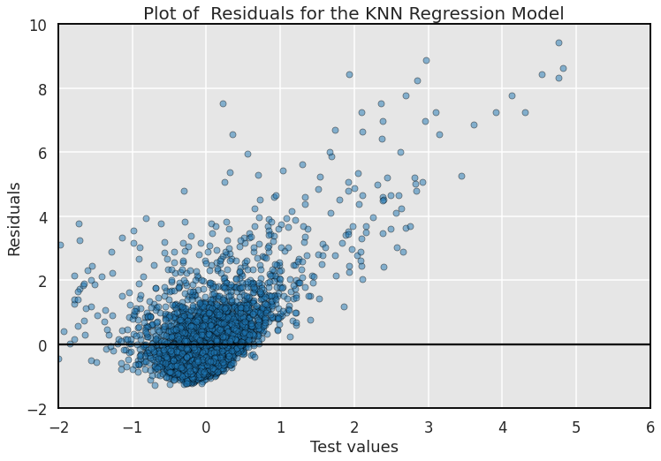
Results
Regression Results:
Linear Regression with ridge regularization (alpha=100)
MSE for training data 0.2925
MSE for testing data 0.3353
R2 score for training data 0.6959
R2 score for testing data 0.6920
Polynomial regression with best degree = 2
MSE for training data 0.1813
MSE for testing data 0.2070
R2 score for training data 0.8115
R2 score for testing data 0.8099
KNN regression with best
neighbour = 6
MSE for training data 0.1456
MSE for testing data 0.2463
R2 score for training data 0.8486
R2 score for testing data 0.7738

Slide 9
Result
Classification Results

